Slide 1


QR Phishing Detector
Name of Student AKTU Roll number
Shambhwi Priya 2300100100361
Under Supervision
Mr. Ayush Kumar

Slide 2

OUTLINE
Introduction
Objective
Phishing check features
Working of QR detector
Data Flow Diagram
Relevance to Real World Problems
Output
Conclusion

Slide 3
INTRODUCTION
QR Codes are widely used for payments, links, and promotions.
Cybercriminals embed malicious/phishing links in QR codes.
Users may unknowingly open harmful websites.
QR Code Phishing Detector helps identify and warn about such suspicious links.

Slide 4
Objective
To scan and decode QR codes from images.
To detect whether the decoded URL is safe or suspicious.
To provide a color-coded result (Safe, Suspicious, Unknown).
To enhance user awareness about phishing through QR codes.

Slide 5
Phishing Check Features
Detects HTTP (not secure) URLs.
Flags shortened links (bit.ly, tinyurl, goo.gl).
Detects direct IP URLs.
Flags very long URLs (possible obfuscation).
Detects typosquatting domains (e.g., g00gle, paypa1).
Marks non-URL text as “Unknown”.

Slide 6
Working of QR Detector
Step 1: Upload a QR image.
Step 2: System extracts pixel data using <canvas>.
Step 3: QR code decoded using jsQR library.
Step 4: Decoded text/URL passed to phishing check function.
Step 5: Result displayed with status and message.

Slide 7
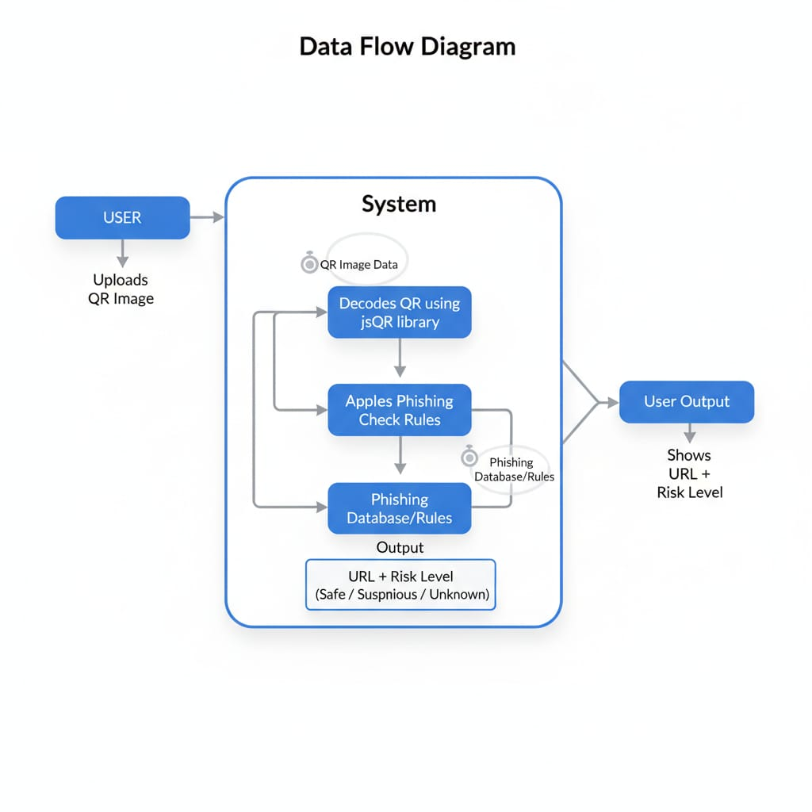
Data Flow Diagram

Slide 8
Relevance to Real-World Problems
Digital Payments
Prevents fake QR scams in UPI, Paytm, PhonePe, etc.
E-commerce & Ads
Protects customers from malicious QR on posters/websites.
Cybersecurity Awareness
Educates users about phishing attempts hidden in QR codes.
Academic & Research
Useful for students and beginners to understand phishing concepts.

Slide 9
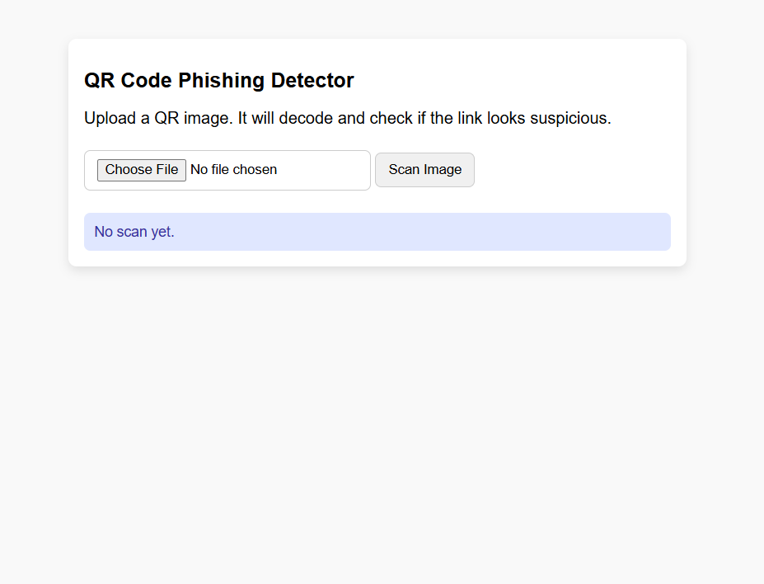
Output

Slide 10
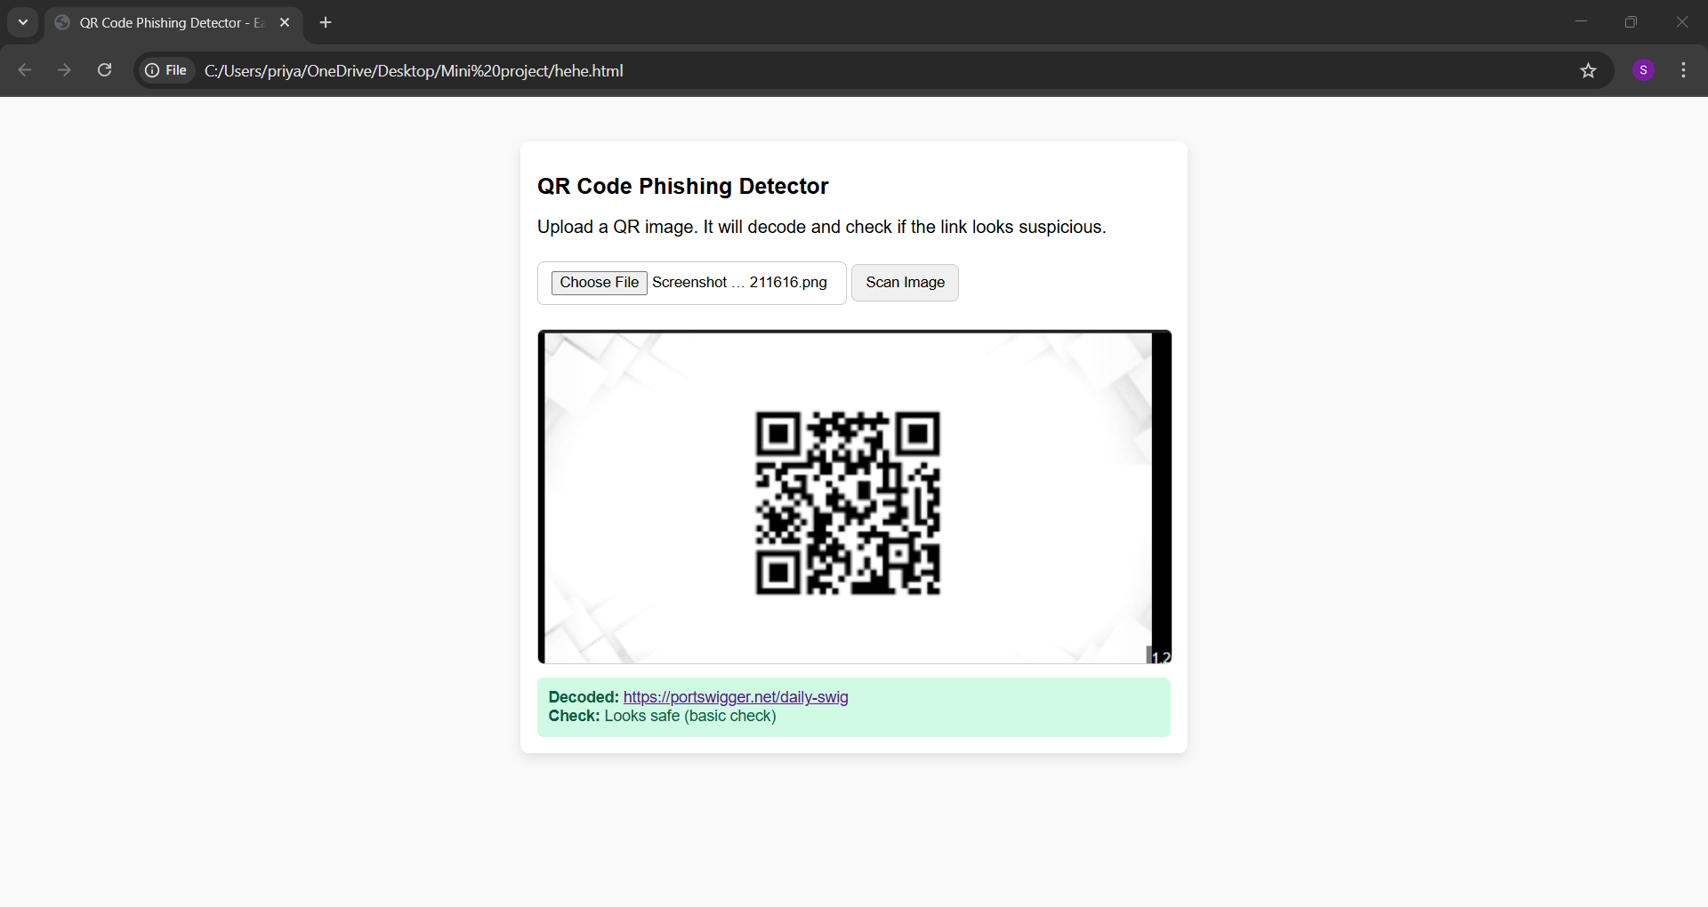
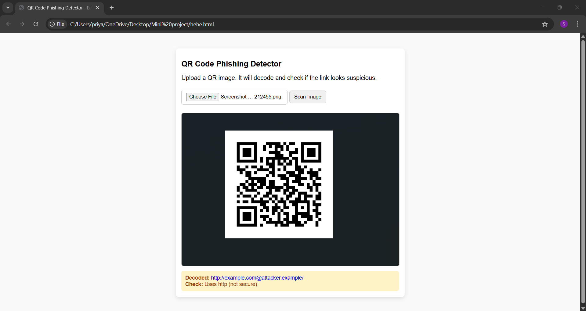
Output

Slide 11
Conclusion
QR phishing is a growing cyber threat.
This detector provides basic heuristic checks for safety.
Helps users stay alert before opening QR links.
Can be extended with Google Safe Browsing API for real-time threat detection.

Slide 12
THANK YOU

